Slide 1

INFS-740 Project Presentation Financial data viewer and analyzer
Anjali Sharma

Slide 2
detail
Technology Stake – Angular Web Development Framework, Flask API, D3 Visualization, Scikit machine learning model
Collections: Total 4
Finance_db_infs740 (Mongo Database)
stock_metadata
stock_financial_info
stock_default_key_stats
stock_history_data
Query #1 – Home Screen data from combination of
stock_metadata, stock_financial_info, stock_default_key_stats
Query #2 – Market Capitalization over $1 Trillion
Stock_metadata, stock_financial_info, stock_default_key_stats
Query #3 – Aggregate highest price among all
Stock_history_data, stock_metadata, stock_financial_info

Slide 3
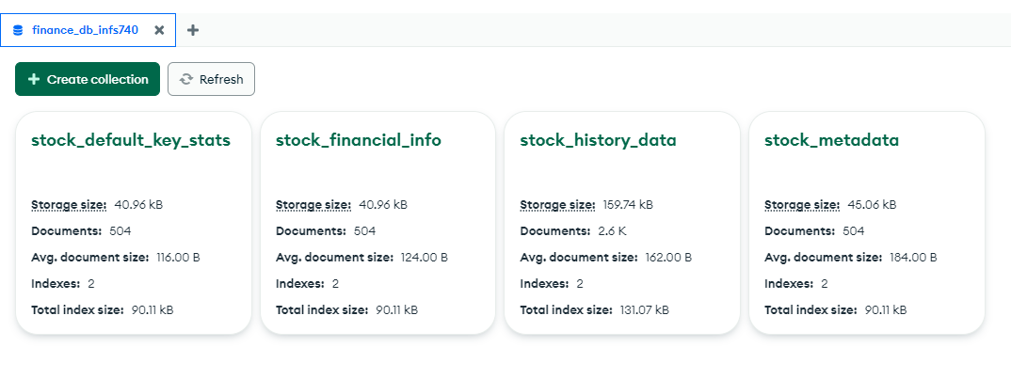
Mongo database collections

Slide 4
apis
get Data http://localhost:5000/getData add finance data http://localhost:5000/addData update finance data http://localhost:5000/updateData/symbol delete finance data by symbol http://localhost:5000/deleteData/symbol get_marketCap_Over_1T http://127.0.0.1:5000/get_marketCap_over_1T get all pricing history http://127.0.0.1:5000/get_all_pricing_history get highest open price http://127.0.0.1:5000/get_pricing_history_highest_open get data to visualize http://127.0.0.1:5000/get_data_to_visualize

Slide 5
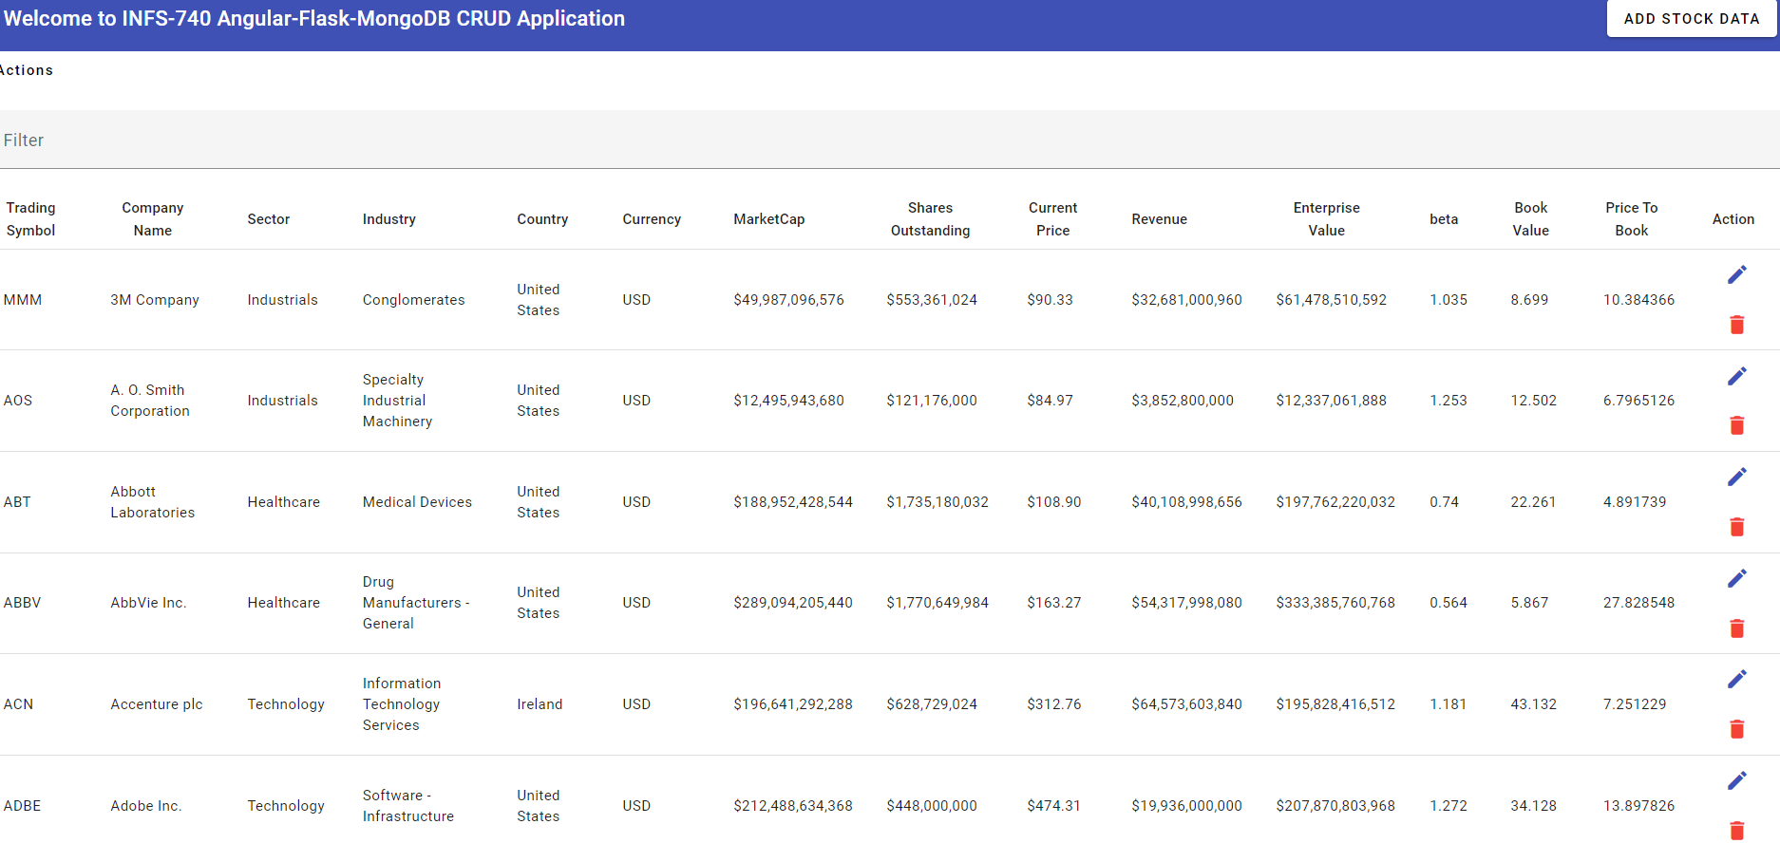
Overcoming nervousness
Home Page:
Collections : stock_metadata, stock_financial_info, stock_default_key_stats
Sorting, filtering, pagination features

Slide 6
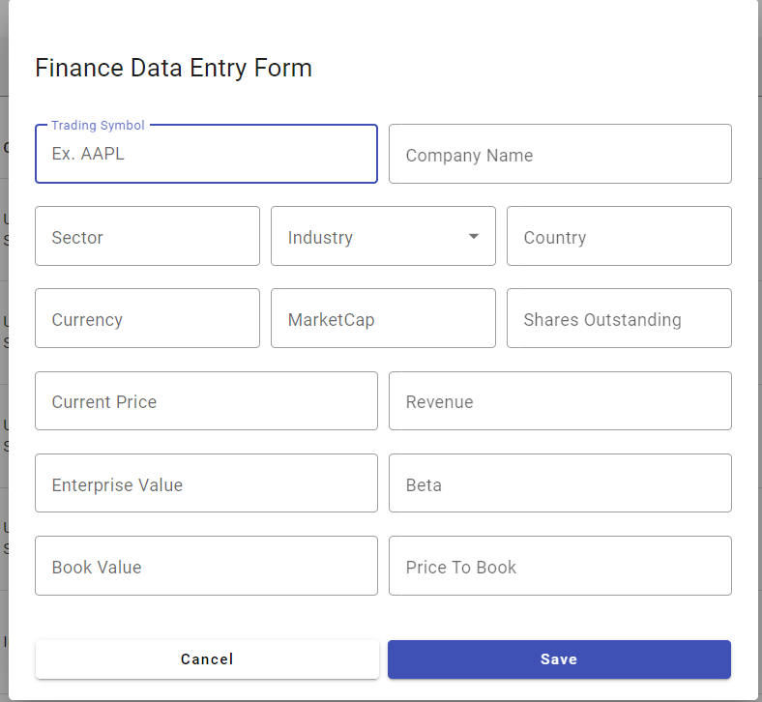
ADD data
Click on ADD STOCK DATA at the Toolbar, the application will present empty form to enter the data. The button text alters between Update and Save as display text based on EDIT or ADD operations. Here since we are adding new record, the text displays as Save. The data will be added to corresponding collections.

Slide 7
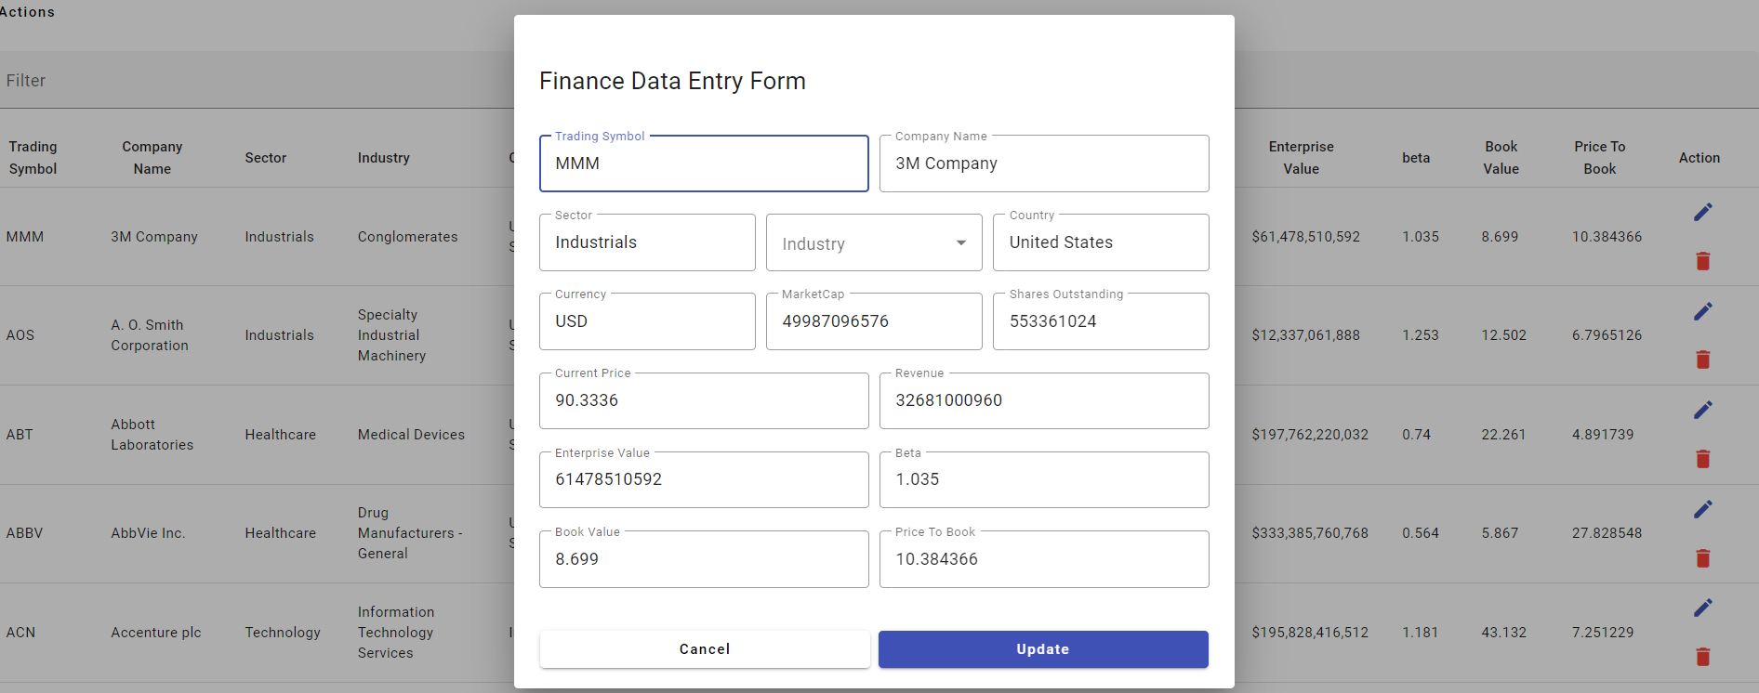
Update the data
Click on Pencil Icon to edit existing record: The button text alters between Update and Save as display text based on EDIT or ADD operations. Here since we are editing existing record the text displays as Update.
The data will be updated to all collections respectively-
Stock_metadata, stock_financial_info and stock_default_key_stats

Slide 8
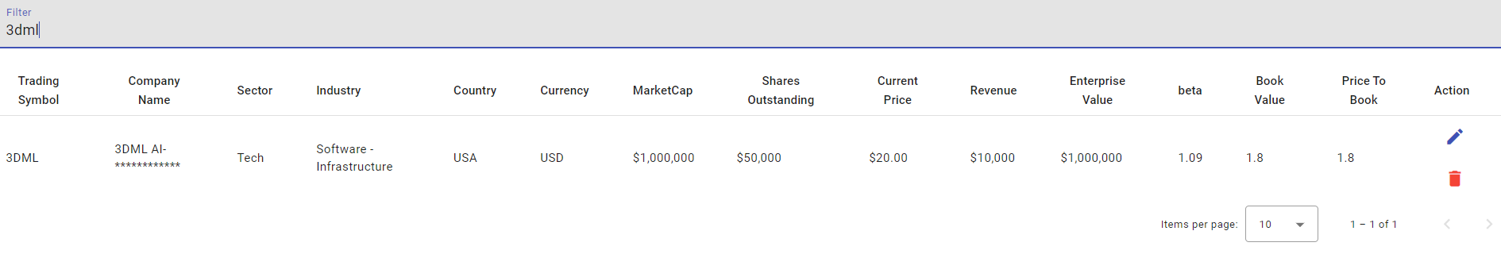
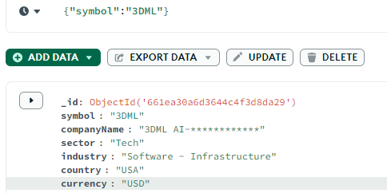
Delete data
Click on Trashcan Icon, the record will be deleted from all corresponding collections. collections. Filter the record you want to delete and click on Trashcan
Search before delete, verify with database and search again after deleting and verify with database.

Slide 9
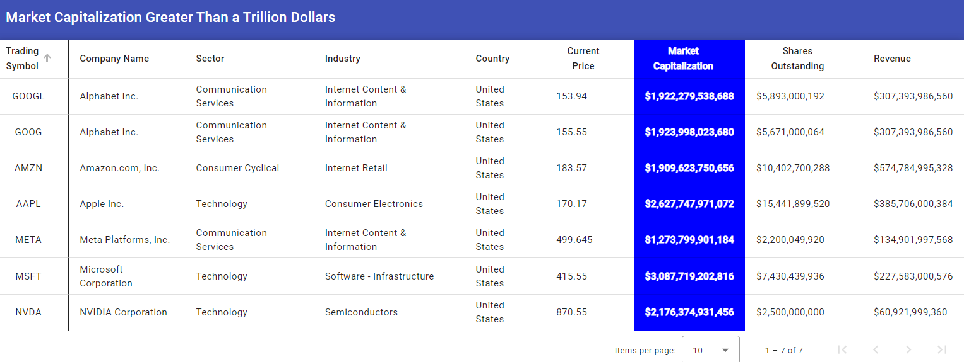
More queries: Market capitalization over $1 trillion
Click on Actions to see menu for additional items:
Specific query marketCap > $1T
Primary collection : Stock_financial_info
Secondary collections after filtering from financial info:
Stock_metadata and stock_default_key_stats

Slide 10
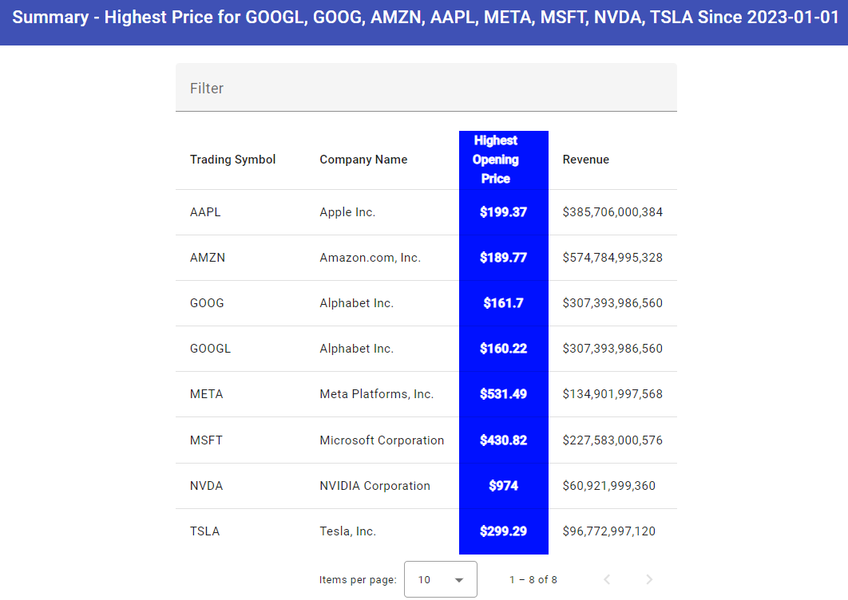
More queries: Highest Pricing – aggregate summary data group by symbol
Click on Actions to see menu for additional items:
Specific query aggregate , group by symbol, get max price among all records
Primary collection : Stock_history_data
Secondary collections after filtering for highest price:
Stock_metadata and stock_financial_info

Slide 11
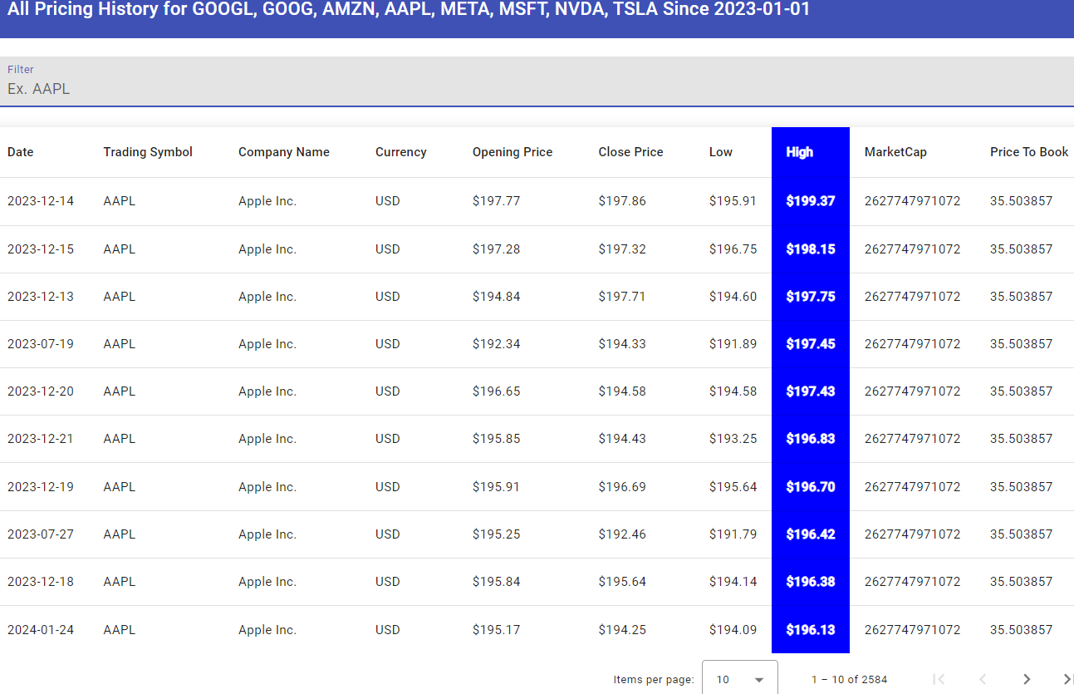
More queries: All Pricing history – verify from this raw data the aggregate summary of highest price
Click on Actions to see menu for additional items:
collections : Stock_history_data, stock_metadata, stock_default_key_stats for symbol match sort by highest price, symbol, date

Slide 12
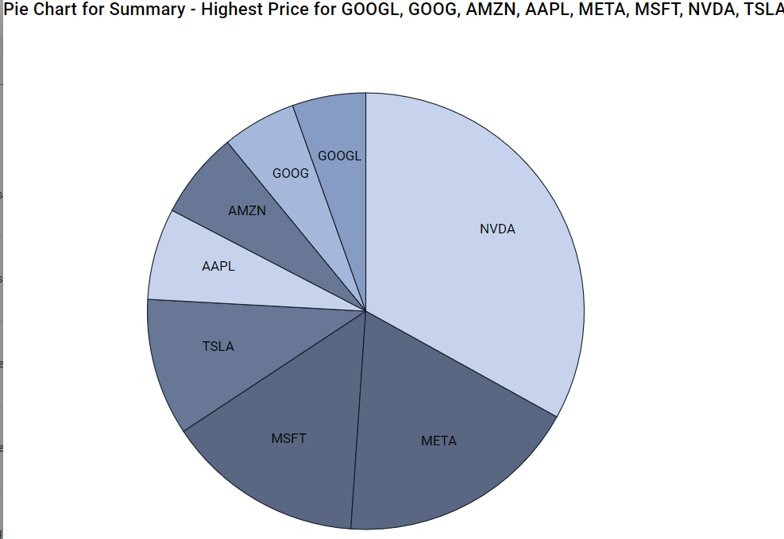
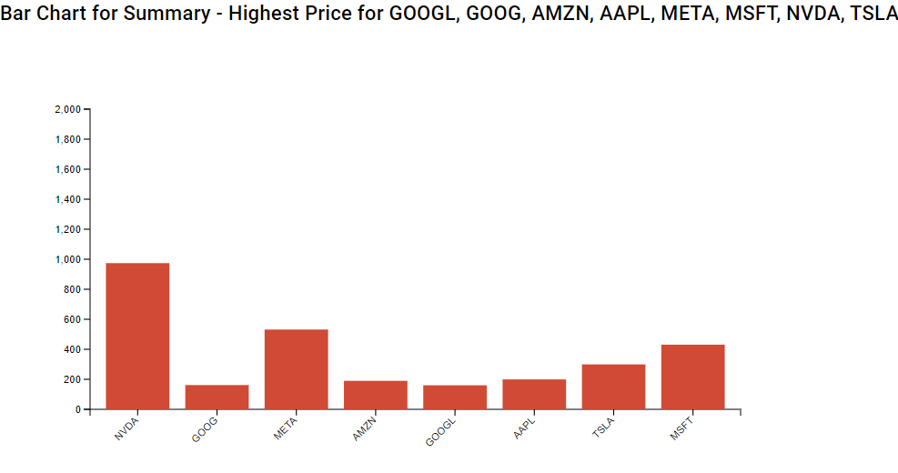
Visualizations bar chart and pie chart for highest price data
Bar Chart
Pie Chart
Bar Chart
Pie Chart

Slide 13
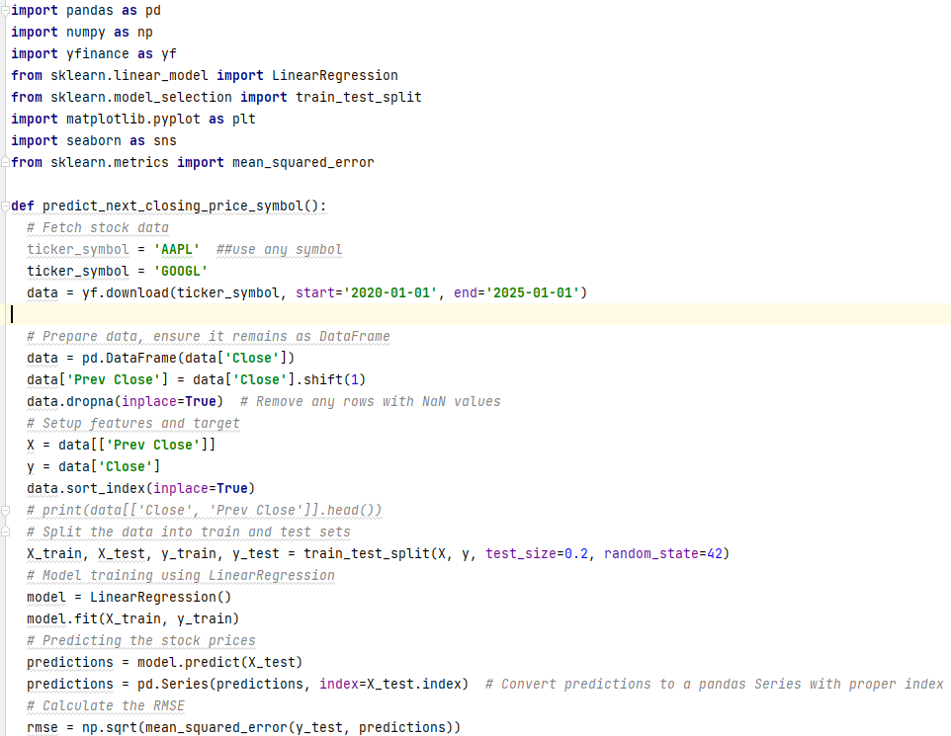
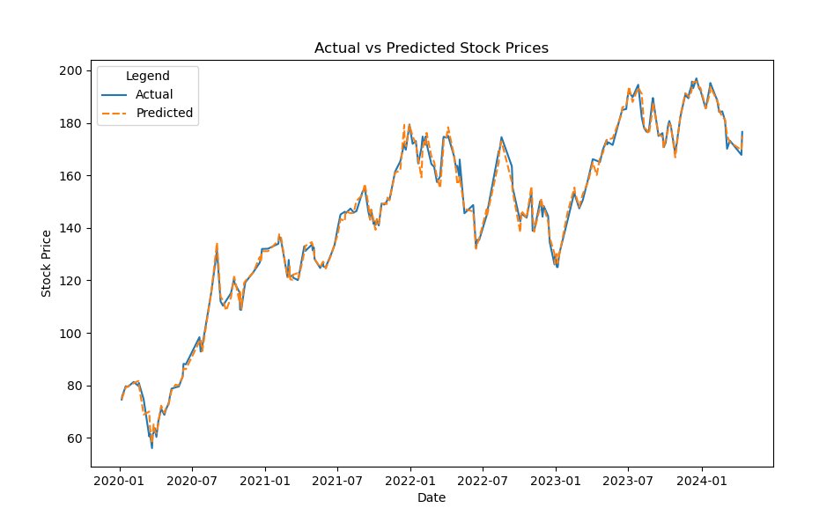
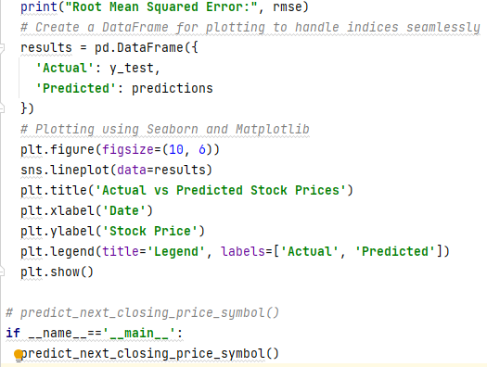
Machine learning linear regression model to predict next closing price of a given trading symbol
Code
Graph

Slide 14
THANK YOU
Anjali Sharma

